Slide 1
INVENTORY Management system
RITHVIK REDDY VANTERU (002728458)
NIKHITHA KRISHNA PRIYA JARABANA (002704393)
ANOUKSHA KOLIGE SREEMURTHY (002658325)
SAHITHI BOMMINENI (002768024)

Slide 2
Contribution
MEMBERS | CONTRIBUTION
ANOUKSHA SREEMURTHY | DDL/DML: Created Tables. Inserted values into : orderlist. Views : supplier_product_details, total_productstock_quantity. Trigger : stock_trigger. Grants : All tables.
NIKHITHA KRISHNA PRIYA JARABANA | DDL/DML: Inserted values into product_stock, category, supplier, delivery . Views :-stock_update, product_quantity_details. Sequence : stock_id, category_id. Exception Handling of tables, Procedures, Cursors.
SAHITHI BOMMINENI | DDL/DML: Inserted values into : product, admin. Views :- Product_Category, Customer_Order_details. Index :- product_stock_index. Grant : User Roles. Exception Handling of Sequence, Functions.
RITHVIK REDDY VANTERU | DDL/DML: Inserted values into store, customers, orders. Views :- Supplier_Store_details, order_details. Trigger :- order_trigger. Sequence : order_id, product_id. Exception Handling of Views, Package.

Slide 3
Problem STATEMENT
In the traditional method, the management does not have a systematic record to keep a track of their inventory data. The data entered in the logbook sometimes gets lost if it is not secured correctly. There is a possibility of human errors in the records maintained as the process is carried out manually and it will be difficult to estimate the sales.

Slide 4
PROPOSED SOLUTION
We have proposed a system that maintains a record of all the products available in the warehouse which stores the information and also securely retrieves the data.

Slide 5
Concepts executed
Tables
Views
Indexes
Triggers
Sequences
Exception Handling
Grants
Cursors,
Functions, Procedure, Packages

Slide 6
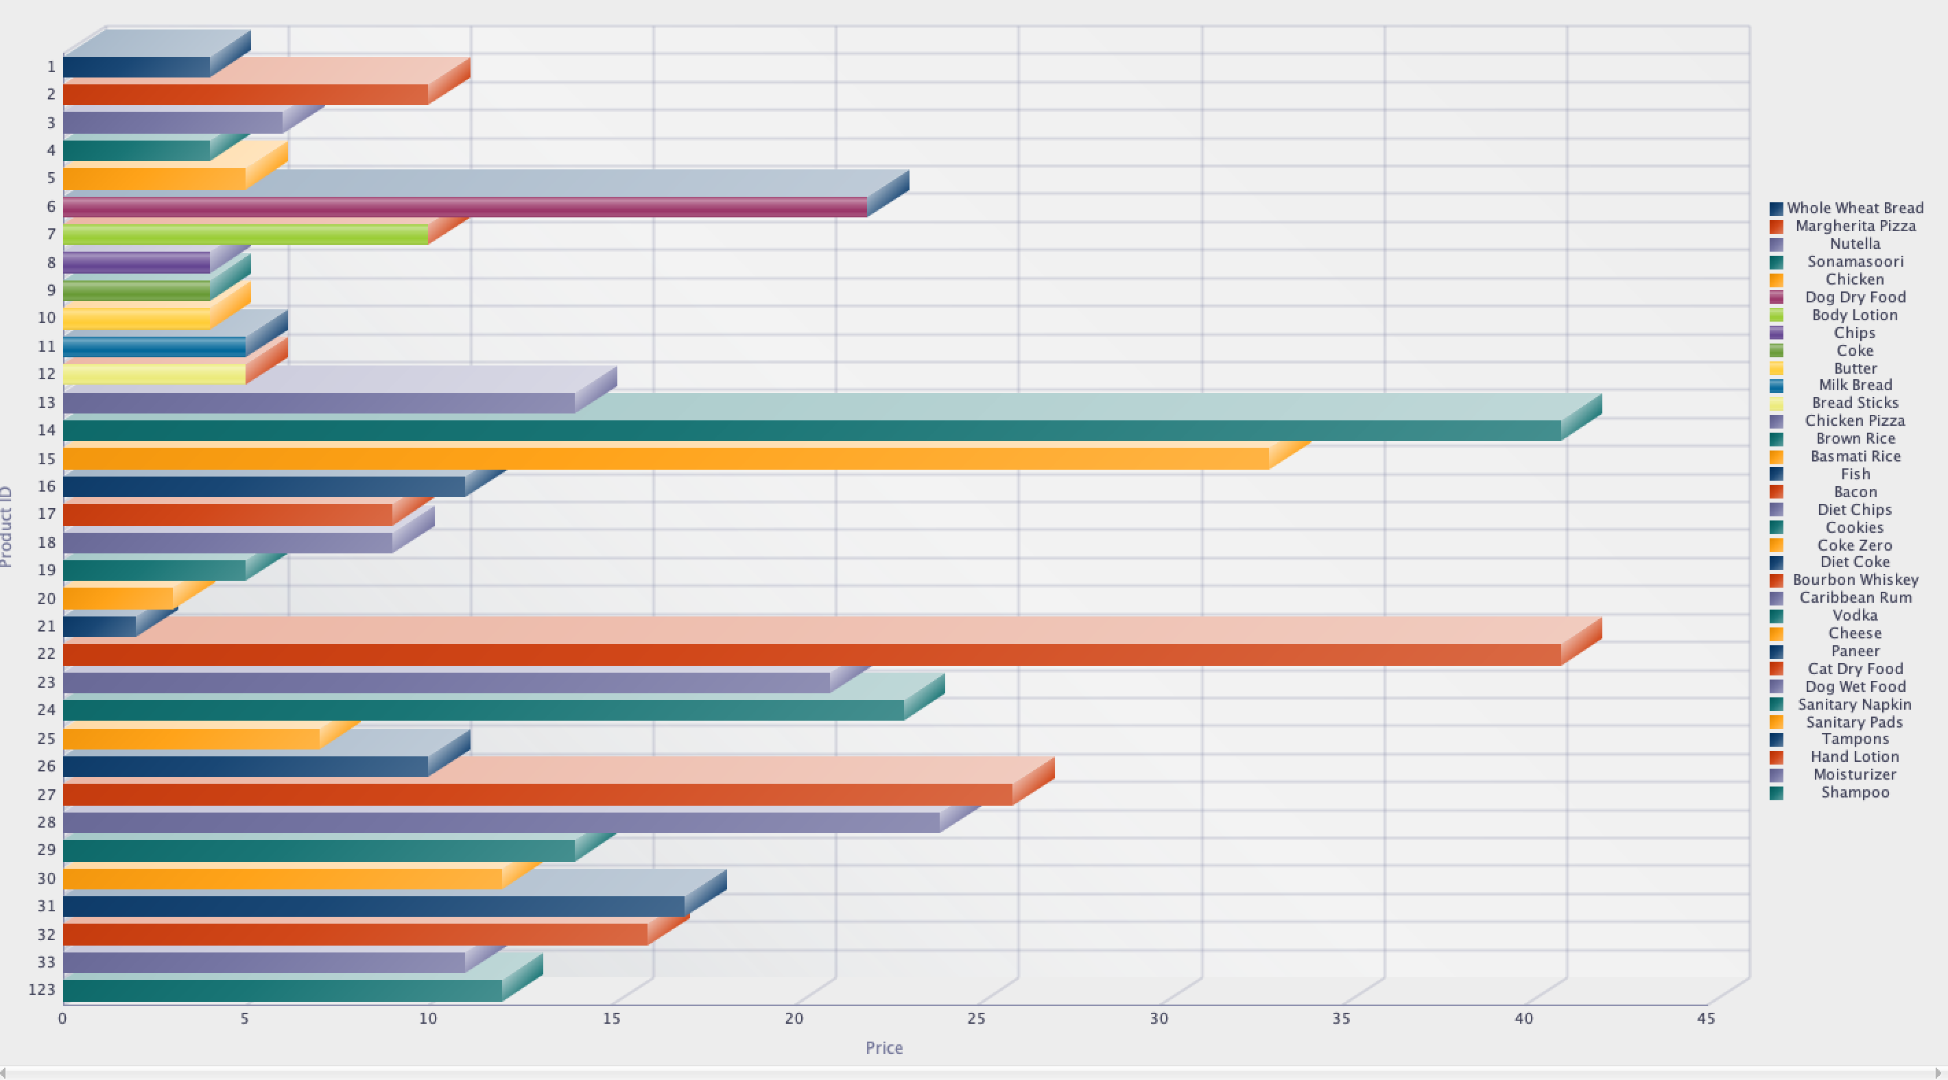
Reports
Product Price: Displays the report for the product and the prices of them which are present in the inventory.

Slide 7
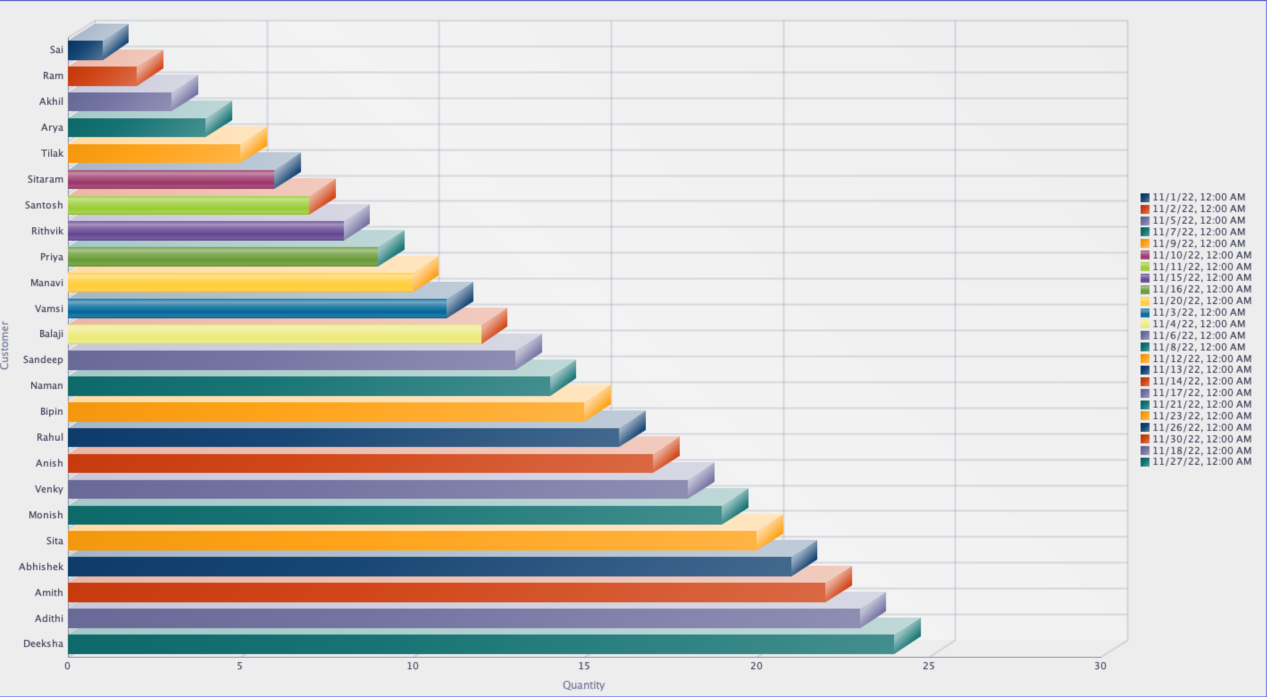
Reports
Customer order details: The report shows the customer name along with the quantity and order date.

Slide 8
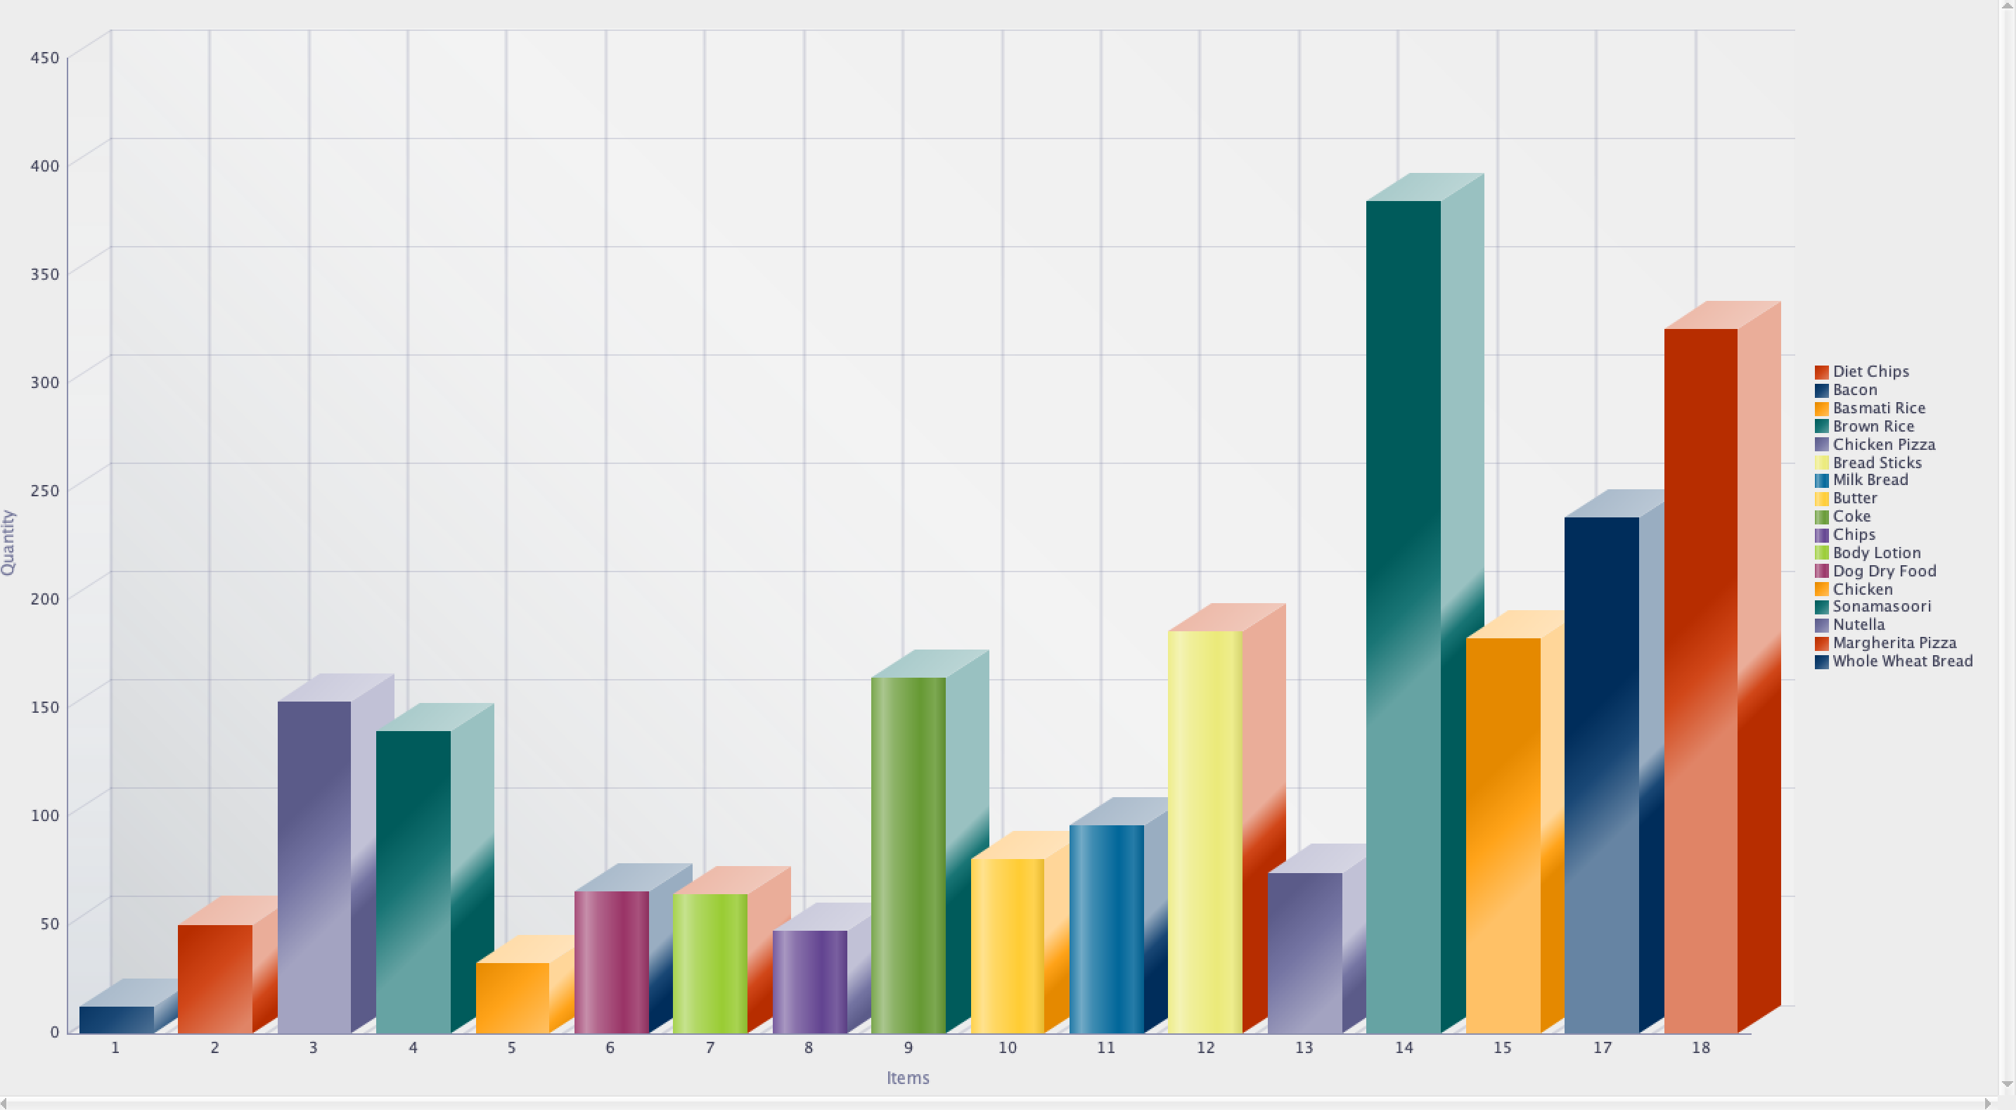
Reports
Stock Update: Shows the product details along with the available quantity.

Slide 9
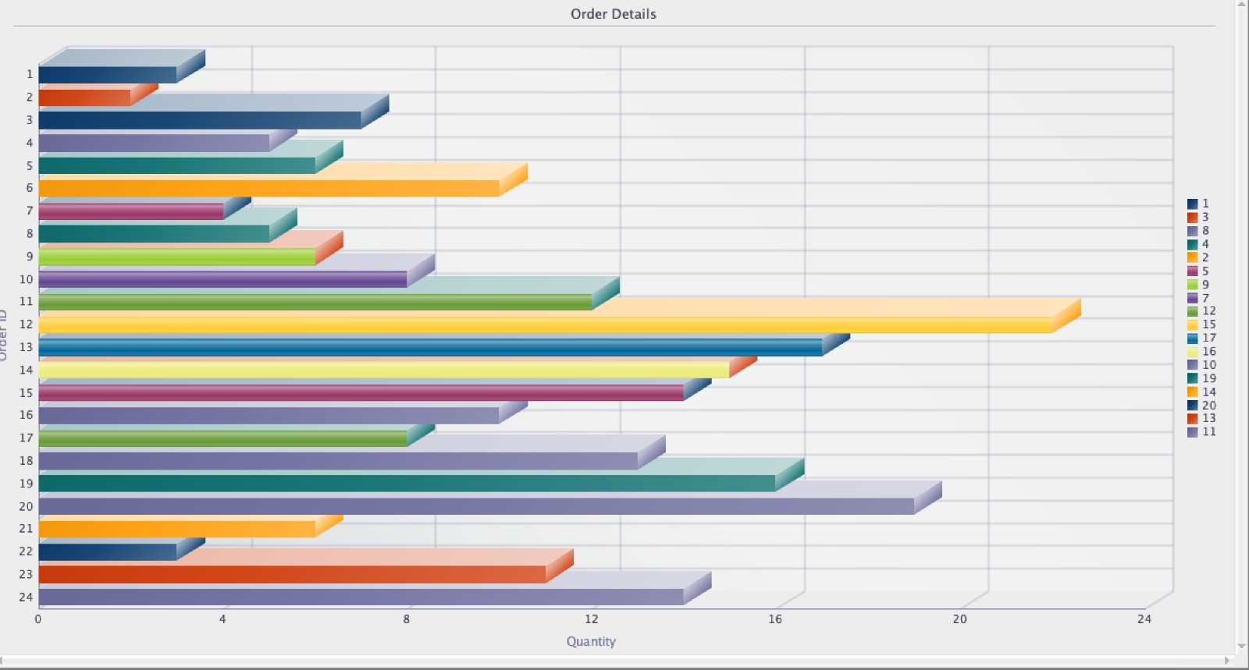
Reports
Order details: The reports display the order details along with the quantity for each order.

Slide 10
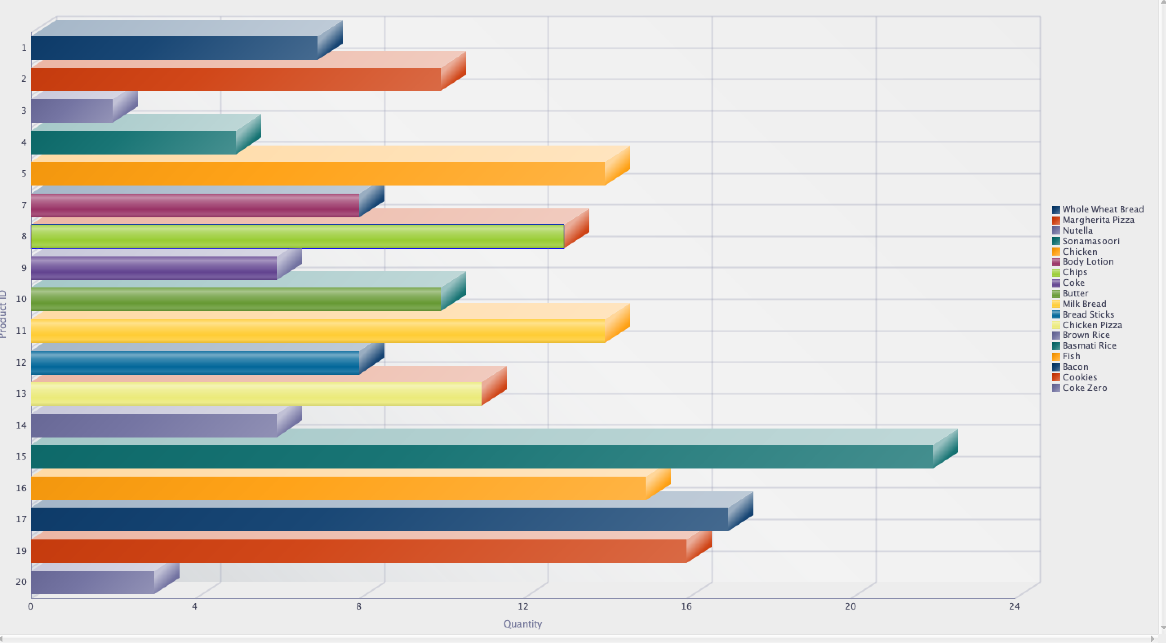
Reports
Product and its ordered quantity: The report generates the product details of each order quantity.

Slide 11
THANK YOU

